Slide 1
Software Quality
Lecture 5
Ruzanna Chitchyan, Jon Bird, Pete Bennett
TAs: Mitch Lui, Craig Barnfield, Ollie Mayers, Kira Clements
Notes:
RC

Slide 2
Overview
Software quality and how to get to it
Test-driven development
  White box testing
  Black box testing
Notes:
Introduce the objectives for the module.

Slide 3
Software Quality

Slide 4
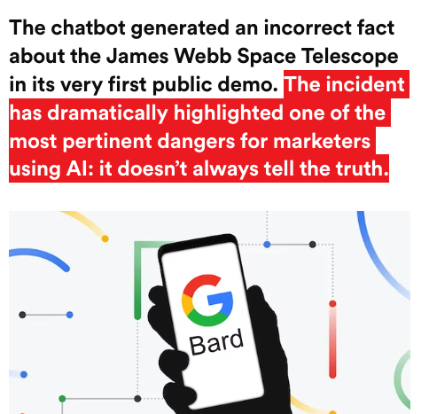
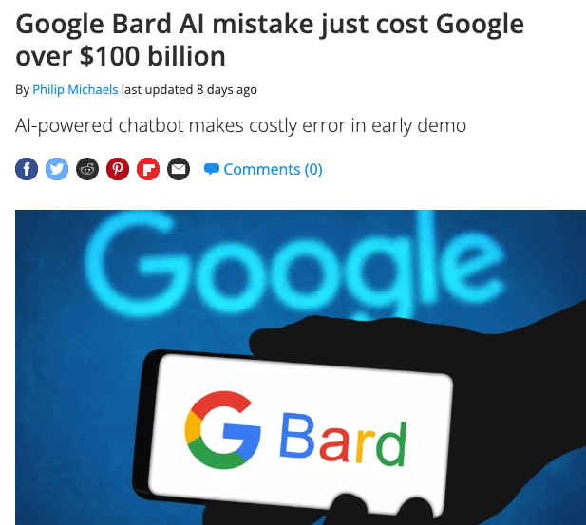
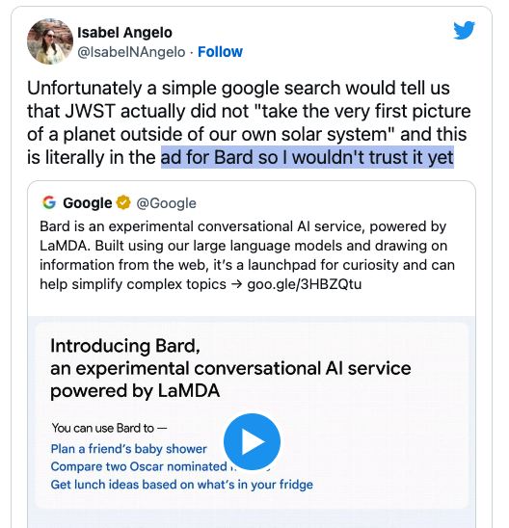
Why is Software Quality relevant: Case of Bard
https://www.tomsguide.com/news/google-bard-ai-is-off-to-an-embarrassing-start
https://www.thedrum.com/news/2023/02/09/attention-marketers-google-s-100bn-bard-blunder-underscores-current-dangers-using-ai

Slide 5
Why is Software Quality relevant?
Reputation
Cost of Product and Maintenance
Software Certification
Organizational Certification
Legality
Moral/ethical codes of practice
Notes:
Reputation Software developers and their organisations rely on reputation. A poor quality product (or family of products) can be enormously damaging for business. Software bugs can have immediate impacts on custom, especially in customer-facing industries. The automotive software problems with Volkswagen have led to an enormous amount of negative publicity, which has a direct impact on sales.
Limiting Costs of Product and Maintenance Cost is an overriding factor in software development. Poor quality software tends to be expensive to develop and to maintain, which can have a detrimental effect on business. Poor software quality can lead to technical debt, where the organisation in charge of the software needs to invest a disproportionate amount of resources into maintaining and running the software to make up for (and to try and remedy) poor design and implementation decisions.
Software Certification Depending on the domain of the software (e.g. in Aircraft or Rail), the development and use of software might be restricted, and dependent on obtaining some form of certification. For example, software in modern civilian aircraft often has to be certified to the DO178 standard, which requires the extensive use of software quality assurance procedures throughout the software development lifecycle.
Organisational Certification The organisational procedures and structures that are employed for software development can have a huge bearing on the quality of the software they produce. There are various ways by which to categorise the extent to which an organisation employs good practice. International certification procedures and standards such as CMM and ISO90017 exist, so that software development organisations can advertise their “capability” to develop high quality software.
Legality Depending on the country, there may be overriding legal obligations that apply to organisations that use software. For example, in the UK, organisations have to demonstrate that the risk posed by their technology (this includes software) is “As Low As Reasonably Practicable” or “ALARP” . In other words, every “practicable” measure must have been taken to demonstrate that (in our case) the software system does not pose a risk to its users.
Moral / ethical codes of practice Even in cases where a software system is not covered by industrial certification and legislation, and where its failure is not necessarily business or safety-critical, there can remain a moral obligation to the users. Professional organisations such as the American Computer Society (ACM) have explicit ethical guidelines and codes of practice, with statements such as “Software engineers shall act consistently with the public interest”. This clearly implies that they ought to do whatever possible to maximise the quality of their software and to prevent it from containing potentially harmful bugs.

Slide 6
Software Quality is Multi-dimensional
Subjective or “fitness for use”: as perceived by an individual user (e.g., aesthetics of GUI, missing functionality…)
Objective or “conformance to requirements”: can be measured as a property of the product (e.g., detailed documentation, number of bugs, compliance with regulations …. )
Practical: what does it mean to your team and your clients?
Notes:
Fitness for use: Joseph Juran embodied the idea that the quality of product revolves around its fitness for use . He argued that, ultimately, the value of a product depends on the customer’s needs. Crucially, it forges the product developers to focus on those aspects of the product that are especially crucial (the vital few objectives) as opposed to the useful many.
Conformance to Requirements: Phil Crosby embodied a different tone. He defined quality as “conformance to requirements” . His opinion was that quality can be achieved by the disciplined specification of these requirements, by setting goals, educating employees about the goals, and planning the product in such a way that defects would be avoided.

Slide 7
Quality Models: ISO/IES25010

Slide 8
Steps Towards Software Quality:
Use a standard development process
Use a coding standard
      Compliance with industry standards (e.g., ISO, Safety, etc.)
      Consistent code quality
      Secure from start
      Reduce development costs and accelerate time to market
  Define and monitor metrics (defect metrics and complexity metrics)
      High complexity leads to higher number of defects
  Identify and remove defects
      Conduct manual reviews
      Use Testing

Slide 9
Testing
Mauro Pezze and Michal Young. Software testing and analysis - process, principles and techniques. Wiley, 2007.

Slide 10
Testing process: key elements and relationships
From: M. Staats, M. W. Whalen, and M. P. E. Heimdahl. Programs, tests, and oracles: the foundations of testing revisited. In Software Engineering (ICSE), 2011 33rd International Conference on, pages 391–400. IEEE, 2011.
Notes:
System under Test (SUT) This is the system (or unit/function) being tested. It seeks to implement the specification.
The SUT can either be a white-box system, where we have complete access to the source code and the run-time state (e.g. the call-stack), or a black-box system, where we only have access to the external interface or API (depending on the type of system). It can also be a mixture of the two; for example, library routines might be provided in the form of closed source components, whilst the source code for the main core of the system is available for analysis.
The system might be reactive where the input / output behaviour at one stage is affected by previous inputs (e.g. a GUI), or it might process inputs in a single batch and return to its initial state. This matters from a testing perspective, because in the reactive case, the test inputs have to be formulated as sequences.
The system might be deterministic, where it always returns the same answer for a given input. It might however also be non-deterministic, where the same input can elicit different outputs (perhaps because of randomised internal behaviour, or other factors beyond control such as thread-scheduling).
It is commonly important to ensure that the SUT is an isolated version of the “live” system.
Specification A specification represents the idealised behaviour of the system under test. Depending on the development context, this might be embodied as a comprehensive, rigorously maintained document (e.g. a set of UML diagrams or a Z specification). Alternatively, if developed in an agile context, it might be a partial intuitive description captured in a selection of user stories, test cases, and documented as comments in the source code.
The nature of the specification has an obvious bearing on testing. If a concrete, reliable specification document exists and there is a shared understanding of what the system is supposed to do, this can be used as the basis for a systematic test-generation process. If this is not the case, then testing becomes a more ad-hoc and dependent upon the intuition and experience of the tester.
Test cases The test cases correspond to the executions of the SUT. In practical terms a test case corresponds to an input (or a sequence of inputs) to the system.
Test cases should ideally cumulatively execute every distinctive facet of software behaviour. An ideal test set (collection of test cases) should be capable of exposing any deviation that the SUT makes from the specification. If it can be shown to do this, the test set is deemed to be adequate.
Test Oracle Executing the test cases alone will not determine whether the SUT conforms to the specification or not. This decision – whether or not the output of a test is correct or not – is made by a test oracle. In practice, an oracle might be an assertion in the source code that is checked during the test execution, or it might be the human user, deciding whether or not the behaviour is acceptable.
Test oracles are notoriously difficult to produce. There is in practice rarely an explicit, comprehensive, up to date specification that can be used as a reference. A successful software has usually been developed over the course of decades by a multitude of developers, which means that, ultimately, there is rarely a definitive record of how exactly the system should behave. What’s more, there may be tens of thousands of test cases, each of which might produces complex outputs, which can make the task of manual validation of the outputs prohibitively time consuming. These issues are collectively referred to as the oracle problem.

Slide 11
Testing: White Box
Mauro Pezze and Michal Young. Software testing and analysis - process, principles and techniques. Wiley, 2007.

Slide 12
White Box Testing
Access to software ``internals’’:
  Source code
  Runtime state
  Can keep track of executions.
White box testing exploits this to
  Use code to measure coverage
    Many different ways
  Drive generation of tests that maximise coverage

Slide 13
White Box Testing
Access to software ``internals’’:
  Source code
  Runtime state
  Can keep track of executions.
White box testing exploits this to
  Use code to measure coverage
    Many different ways
  Drive generation of tests that maximise coverage.

Slide 14
White-Box Testing
Coverage Metrics:
Statement coverage
Branch coverage
Def-Use or Dataflow coverage
MC/DC (Modified Condition / Decision Coverage)
Mutation coverage…
Prescribed metrics, e.g., DO178-B/C standard for civilian aircraft software
non-critical - statement coverage
safety-critical - MC/DC coverage
Notes:
Statement coverage: The proportion of executable statements in the program that have been executed.
Branch coverage: The proportion of all of the logic-branches in the source code (e.g. outcomes of IF, WHILE, or FOR statements) to have been executed.
Def-Use or Dataflow coverage: The source code is analysed to extract the def-use relations, which relate statements at which a variable is defined (i.e. instantiated and given a value) to subsequent statements using that definition. The test-goal is to cover all of the possible def-use relations.

Slide 15





Statement Coverage
Test inputs should collectively have executed each statement
If a statement always exhibits a fault when executed, it will be detected
Computed as:
  Coverage =

Slide 16









Branch Coverage
Test inputs should collectively have executed each branch
Subsumes statement coverage
Computed as:
  Coverage =

Slide 17
However….

Slide 18
Testing: Black Box
Mauro Pezze and Michal Young. Software testing and analysis - process, principles and techniques. Wiley, 2007.

Slide 19
Black Box Testing
No access to “internals”
  May have access, but don’t want to
We know the interface
  Parameters
  Possible functions / methods
We may have some form of specification document

Slide 20
Testing Challenges
Many different types of input
Lots of different ways in which input choices can affect output
An almost infinite number of possible inputs & combinations

Slide 21
Equivalence Partitioning (EP) Method
Identify tests by analysing the program interface
Decompose program into “functional units”
Identify inputs / parameters for these units
For each input
  Identify its limits and characteristics
  Define “partitions” - value categories
  Identify constraints between categories
  Write test specification

Slide 22
Example – Generate Grading Component
The component is passed an exam mark (out of 75) and a coursework (c/w) mark (out of 25), from which it generates a grade for the course in the range 'A' to 'D'. The grade is calculated from the overall mark which is calculated as the sum of the exam and c/w marks, as follows:
greater than or equal to 70 - 'A'
greater than or equal to 50, but less than 70 - ‘B’
greater than or equal to 30, but less than 50 - ‘C’
less than 30 - 'D'
Where a mark is outside its expected range then a fault message ('FM') is generated. All inputs are passed as integers.

Slide 23
EP – 1. Decompose into Functional Units
Dividing into smaller units is good practice
  Possible to generate more rigorous test cases.
  Easier to debug if faults are found.
E.g.: dividing a large Java application into its core modules / packages
Already a functional unit for the Grading Component example

Slide 24
EP – 2. Identify Inputs and Outputs
For some systems this is straightforward
  E.g., the Triangle program:
    Input: 3 numbers,
    Output: 1 String
  E.g., Grading Component
    Input: 2 integers: exam mark and coursework mark
    Output: 1 String for grade
For others less so. Consider the following:
  A phone app.
  A web-page with a flash component.

Slide 25
EP – 3.a Identify Categories
Category | Description
Valid | valid exam mark
 | valid coursework mark
 | valid total mark
Invalid | invalid exam mark
 | invalid coursework mark
 | Invalid total mark

Slide 26
EP: 3.b Define “Partitions” - value categories
Significant value ranges / value-characteristics of an input
Category | Description | Partition
Valid | EM_1 valid exam mark | 0 ≤ Exam mark ≤ 75
 | CM_1 valid coursework mark | 0 ≤ Coursework mark ≤ 25
Invalid | EM_2 invalid exam mark | Exam mark > 75
 | EM_3 invalid exam mark | Exam mark < 0
 | EM_4 invalid exam mark | alphabetic
 | EM_5 invalid exam mark | real number
 | CM_2 invalid coursework mark | Coursework mark > 25
 | CM_3 invalid coursework mark | Coursework mark < 0
 | CM_4invalid coursework mark | alphabetic
 | CM_5 invalid coursework mark | real number

Slide 27
EP – 3. c Identify Constraints between Categories
Not all categories can combine with each other
Category |  | Condition
valid exam mark | EM_1 | 0 ≤ Exam mark ≤ 75
invalid exam mark | EM_2 | Exam mark > 75
invalid exam mark | EM_3 | Exam mark < 0
invalid exam mark | EM_4 | alphabetic
invalid exam mark | EM_5 | real number
valid coursework mark | CM_1 | 0 ≤ Coursework mark ≤ 25
invalid coursework mark | CM_2 | Coursework mark > 25
invalid coursework mark | CM_3 | Coursework mark < 0
invalid coursework mark | CM_4 | alphabetic
invalid coursework mark | CM_5 | real number

Slide 28
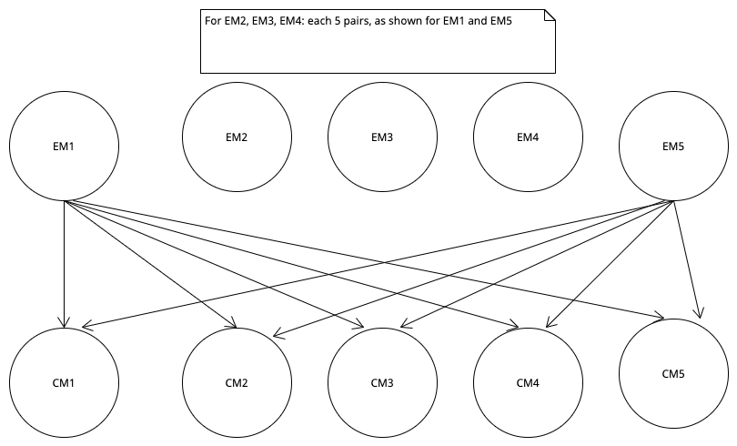
EP – 3. d Write Test Specifications

Slide 29
Example: Inputs and Expected Outputs

Slide 30
Boundary Values
Most frequently errors occur in "edge" cases
  Test just under boundary value
  Test just above the boundary value
  Test the boundary value

Slide 31
How do we go about using this?
Testing applied in Java unit
Use JUnit
  uses “Assertions” to test the code
  Allow us to state what should be the case
  If assertions do not hold, JUnit’s logging mechanisms reports failures
  Various types of assertion are available, e.g., assertEquals( expected, actual ); assertTrue( condition ); assertFalse( condition ); assertThat ( value, matchingFunction )

Slide 32
Review
What is Software Quality?
What are key elements and relationships for test specifications?
How do we carry out white-box testing?
How do we carry out black-box testing?
Notes:
A. System behavior is how a system acts and reacts. It is an outwardly visible and testable activity of a system.
B. A use-case model describes a system’s functional requirements in terms of use cases. It is used to communicate with the end users and the domain experts. A benefit includes buy-in at an early stage of system development.
C. An actor is anything that exchanges data with the system and is external to the system. A use case is a sequence of actions a system performs that yields an observable result of value to a particular actor.
D. An activity diagram in the use-case model can be used to capture the activities in a use case. It is essentially a flow chart, showing flow of control from activity to activity.

